Slide 1


Why AI is Essential for Emerging Leaders
by Jayesh Sharmila

Slide 2
Understand the Transformative Impact of AI on Leadership
Artificial Intelligence is transforming every industry and aspect of life, creating new opportunities and challenges for leaders.
AI is changing the way we work, communicate, and make decisions, requiring leaders to adapt and embrace this new reality.

Slide 3

Harness AI for Data-Driven Decision Making
100%
50%
Efficiency
Predictive
AI can analyze vast amounts of data to identify patterns and trends, providing valuable insights for strategic decision-making.
AI-powered predictive analytics can help leaders anticipate challenges and opportunities, making proactive decisions.

Slide 4

Leverage AI for Personalized Leadership Development
1
Tailored Programs
2
Personalized Feedback
AI can analyze individual strengths and weaknesses, customizing training programs for optimal leadership development.
AI-powered coaching tools offer real-time feedback and guidance, helping leaders improve their performance.

Slide 5



Integrate AI to Drive Diversity and Inclusion
Bias Mitigation
Global Collaboration
AI can help identify and mitigate unconscious bias, creating more equitable and inclusive workplaces.
AI-powered communication tools facilitate collaboration across diverse teams and cultures, promoting inclusivity.

Slide 6
Empower Leaders to Manage AI-Driven Disruptions
Adaptability
1
AI is rapidly changing the business landscape, requiring leaders to adapt to new technologies and processes.
Innovation
2
Leaders must embrace AI and leverage its potential to drive innovation and create new competitive advantages.
Resilience
3
AI-driven disruptions can create uncertainty, necessitating strong leadership to navigate change and build resilience.

Slide 7

Cultivate AI-Augmented Human Leadership Skills
Critical Thinking
Communication
Creativity
Leaders must be able to critically evaluate AI-generated insights, ensuring ethical and effective decision-making.
Leaders need to effectively communicate AI-related concepts to diverse audiences, building trust and understanding.
AI can augment human creativity, but leaders must be able to harness its power to generate innovative solutions.

Slide 8



Navigate the Ethical Considerations of AI in Leadership
Fairness
1
AI algorithms must be designed and implemented fairly, avoiding bias and discrimination.
Transparency
2
Leaders must ensure transparency in AI decision-making, providing clarity to stakeholders.
Accountability
3
Leaders must be accountable for the ethical use of AI, taking responsibility for its impact on society.

Slide 9
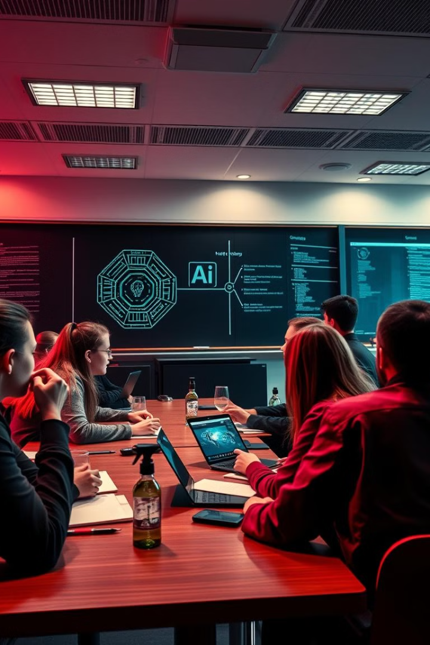



Prepare Emerging Leaders for an AI-Driven Future
Upskilling
Emerging leaders must acquire new skills and knowledge related to AI, data science, and digital transformation.
Mentorship
Mentorship programs can help guide and support emerging leaders as they navigate the challenges of AI leadership.
Innovation
Leaders must foster a culture of innovation, encouraging experimentation and exploration of AI-driven solutions.

Slide 10

Conclusion: The Key Role of AI in Future-Proofing Leadership
AI is not simply a tool but a fundamental force reshaping leadership. By embracing AI's potential, leaders can equip themselves and their organizations for a future of unprecedented opportunity.

